Slide 1
Defences Against Low-Level Software Vulnerabilities Dr Federica Paci
COMP6236 - Software Engineering and Cyber Security

Slide 2
Last time
What is Buffer Overflow
Variants of Buffer Overflows
Stack Overflows
Heap Overflows
Integer Overflows
Format String Overflows

Slide 3
Today
Countermeasures
Secure Coding
Stack canaries
Non-Executable Stack
Address Space Layout Randomization (ASLR)
Lab on buffer overflow

Slide 4
Learning outcomes
By the end of this session you will be able to
Understand rules of secure coding in C
Understand several automatic defenses against memory-based attacks

Slide 5
Buffer overflow
Guess the memory address of the shellcode
Copy the string (NOP + shellcode + address) into buffer
Overwrite the return address with shellcode’s address
void func (char *arg1)
{
char buffer[4];
strcpy(buffer, arg1);
}

Slide 6
Defense Strategies
Avoid the buffer overflow entirely
Secure coding
Code Review
Static Analysis
Testing
Make the buffer overflow harder to exploit
Examine necessary steps for exploitation, make one or more of them difficult, or impossible

Slide 7
Secure Coding
strcpy operates on null terminated strings and performs no bounds checking
void func (char *arg1)
{
char buffer[4];
strcpy(buffer, arg1);
}
void func (char *arg1)
{
char buffer[4];
strlcpy(buffer, arg1,sizeof(buffer));
}

Slide 8
Unsafe C functions
gets() – reads input without checking. Don’t use it!
strcpy() – strcpy(dest, src) copies from src to dest
If src longer than dest buffer, keeps writing!
strcat() – strcat(dest, src) appends src to dest
If src + data in dest longer than dest buffer, keeps writing!
printf() – prints arguments as specified by format specifiers
If there are no arguments matching format specifiers keeps printing!

Slide 9
Alternative Safe Functions
strcpy() → strlcpy()
strncpy() → strlcpy()
strcat() → strlcat()
strncat()→ strlcat()
sprintf()→ snprintf()
gets() → fgets()

Slide 10

Secure Coding
The best defense is use C functions that support bounds checking
but there are many C/C++ programmers and some are bound to forget
➔ Are there any system defenses that can help?

Slide 11
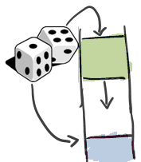
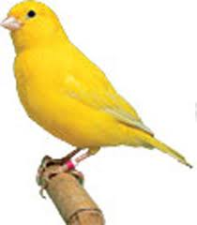

Automatic Techniques
A variety of tricks in combination
Non-Executable Stacks
Canaries
ASLR

Slide 12
Stack Canaries
Goal: make sure we detect overflow of return address
The idea:
The functions' prologues insert a canary on the stack
The canary is a value inserted between the return address and local variables
Types of canaries:
Terminator
Random
Random XOR
The epilogue checks if the canary has been altered

Slide 13
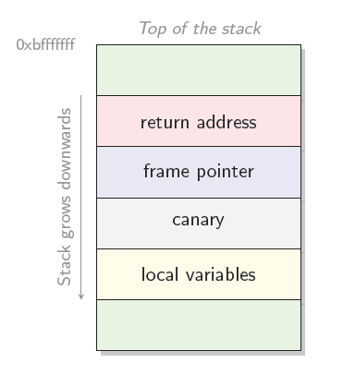
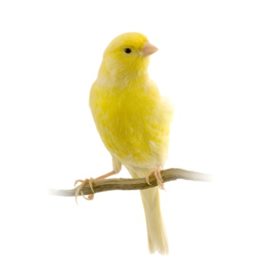

Stack Canaries

Slide 14
Stack Canaries Values
Terminator canaries (CR, LF, NUL (i.e., 0), -1)
Leverages the fact that scanf etc. don’t allow these
Random canaries
Write a new random value @ each process start
Save the real value somewhere in memory
Must write-protect the stored value
Random XOR canaries
Same as random canaries but store canary XOR some control info, instead

Slide 15
Stack Canaries

Slide 16
Stack Canaries Attacks
An attacker may attempt to guess the value of the canary
Include the value in the injection vector used to overflow the buffer
Overwrite the value of the canary with the original value

Slide 17
Stack Canaries Implementations
Stackguard
ProPolice gcc’ stack smashing protector
Microsoft’s Visual C++ .NET

Slide 18
Stack Canaries Limitations
Useful to protect against buffer overflows that overwrites the return address
Do not protect the program from exploits that modify variables, object pointers, or function pointers
Do not protect against heap buffer overflows

Slide 19
Buffer overflow
void func (char *arg1)
{
int authenticated = 0
char buffer[4];
strcpy(buffer, arg1);
if (authenticated){…
}
}
int main ()
{
char *mystr = “AuthMe!”;
func(mystr);
}
M e ! \0
00 00 00 00
A u t h
4d 65 21 00
00 00 00 00
%ebp
%eip
&arg1
buffer
authenticated

Slide 20
Non-Executable Stacks
Goal: Prevent an attacker to execute his code
Idea: mark data memory (stack, heap, ...) as non-executable
Limitations
Prevent only execution of malicious code on the stack
Do not prevent buffer overflow attacks that modify return address, variable, object pointers, and function pointers
Do not prevent buffer overflow in the heap or data segments of the memory of the program
May affect performance

Slide 21
Address Space Layout Randomisation
Goal: Prevent the attacker from guessing the memory address of his code
Idea:
Randomize the address in memory of all code, heap, stack, global variables, stack variables, arrays, etc
Buffer overflow: the attacker does not know the address of the shellcode
Implementations: Linux kernel > 2.6.11, Windows Vista, . . .

Slide 22
ASLR Limitations
Do not prevent the return address on the stack from being overwritten
Do not prevent attacks where the attacker can read the software memory
Do not prevent attacks where the attacker overwrites data
Subject to brute force attack against the number of possible memory layout shuffles (32 bits OS)

Slide 23
Summary
Stack canaries prevent the address to be overwritten
Non-executable stack prevents the attacker code to be executed
ASLR prevents the attacker guesses the memory address of its code

Slide 24
Summary
Automated solutions have major limitations
They usually require OS kernel and/or gcc compiler patching
They may not protect the code in the general case (heap overflow, function pointers, etc.)
They may introduce substantial performance penalties
Code fixing is the ultimate solutions, but only for known vulnerabilities

Slide 25
Reading Material (1)
U. Erlingsson, Y.Younan, F. Piessens. Low-Level Software Security by Example. Handbook of Information and Communication Security, Springer, 2010.
C. Cowan, C. Pu, D. Maier, J. Walpole, P. Bakke, S. Beattie, A. Grier, P. Wagle, and Q. Zhang, StackGuard: Automatic Adaptive Detection and Prevention of Buffer-Overflow Attacks. Proceedings of the 7th USENIX Security Symposium, San Antonio, Texas, January 26-29, 1998.
R. Seacord. Secure Coding in C and C++. Second Edition. Chapter 2.

Slide 26
Reading Material (2)
CERT Secure Coding Standard
https://www.securecoding.cert.org/confluence/display/seccode/SEI+CERT+Coding+Standards
David Wheeler – Secure Programs-HOWTO
http://www.dwheeler.com/secureprograms/Secure-Programs-HOWTO/internals.htm
Matt Bishop – Robust Programming
http://nob.cs.ucdavis.edu/bishop/secprog/robust.html

